Slide 1
Multi-Display Module Introduction
Zhu, Tianyang
Tianyang.zhu@intel.com

Slide 2
Agenda
Software stack
High level design
Related Use cases
Detailed Time-Sequence chart

Slide 3
Multi-Display Software Stack
DisplayObserver
HDMISetting
Audio Service
DisplaySetting(Java API)
StageFright
MultiDisplayService
HWComposer
PSB Video
WIDI
DRM Module
Display HAL
HDMI and Display Driver
2

Slide 4
High Level Design - APIs list
notifyWidi - notify the MDS that Widi is turned on/off
notifyMipi - notify the MDS that Mipi is turned on/off
notifyHotPlug - notify the MDS that HDMI is plugged in/out
updateVideoInfo - update video playback info
registerModeChangeListener - register mode change listener
unregisterModeChangeListener - unregister mode change listener
setModePolicy - set HDMI and MIPI’s policy
setHdmiPowerOff - turn off HDMI’s power
setHdmiModeInfo - set HDMI timing
setHdmiScaleType - set HDMI scale type
setHdmiScaleStep - set HDMI scale step
getHdmiDeviceChange - get HDMI device change status
getVideoInfo - get current playing clip’s information
getMode - get current mode;

Slide 5
High Level Design - Mode’s Bitmap
typedef enum _MDSMode {
MDS_MIPI_ON = 0x1,
MDS_HDMI_CONNECTED = 0x1 << 3,
MDS_HDMI_ON = 0x1 << 4,
MDS_HDMI_CLONE = 0x1 << 5,
MDS_HDMI_VIDEO_EXT = 0x1 << 6,
MDS_WIDI_ON = 0x1 << 7,
MDS_VIDEO_PLAYING = 0x1 << 23,
MDS_HDCP_ON = 0x1 << 24,
MDS_OVERLAY_OFF = 0x1 << 25,
} MDSMode;

Slide 6
High Level Design - Main class
Main Classes Description
Class MultiDisplayClient
public class
every related module includes an instance
Class MultiDisplayComposer
real implementation
Class IExtendDisplayModeChangeListener
for client module registering a callback function;
different client has different behavior after mode change over
Class MultiDisplayService
inherit BinderService

Slide 7
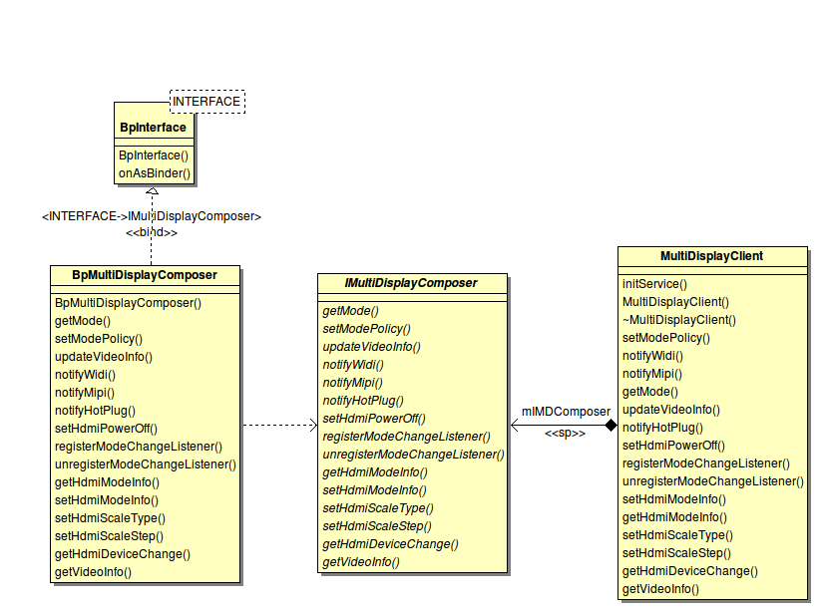
High Level Design - Client Introduction

Slide 8
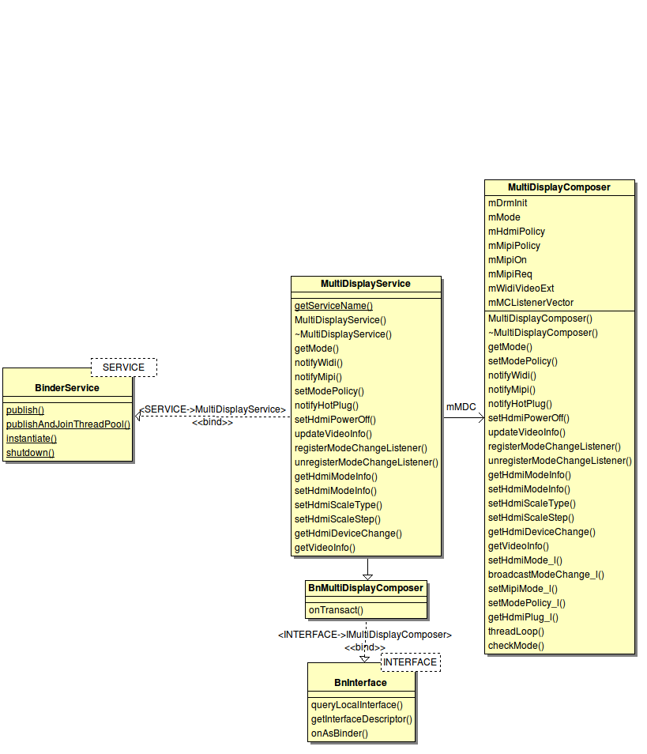
High Level Design - Service Introduction

Slide 9
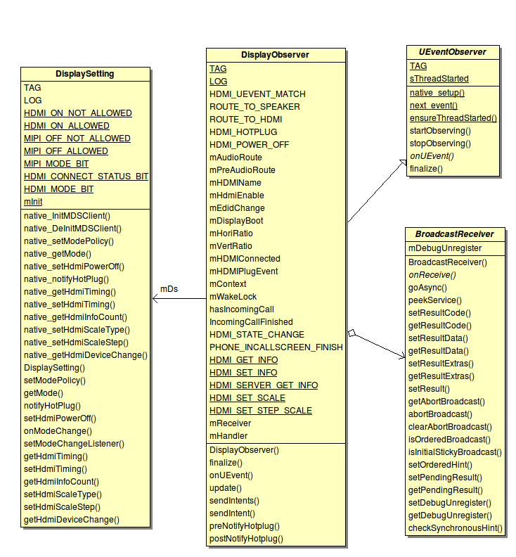
High Level Design – Display-Observer Introduction

Slide 10
Multi-Display Use Cases
Clone Mode
Video Extended Mode
MIPI On/Off
HDMI Hotplug
Privacy Protection
HDMI Timing Dynamic Setting
Supported Use Cases
Widi
Video Rotation
Protected Content
HDCP

Slide 11
Extended Mode Switching
AweSomeplayer/Nuplayer
Start
Extractor
setVideoSource
Load OMX component
initRender
setDisplaySink

Slide 12
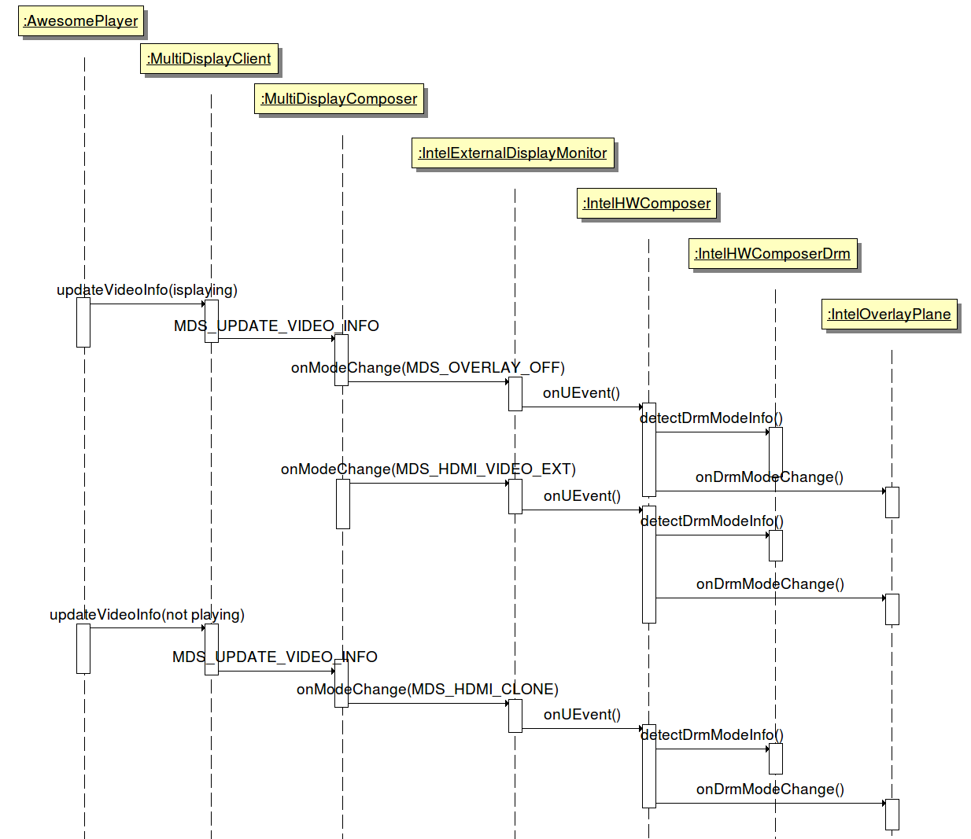
Extended Mode Switching Sequence

Slide 13
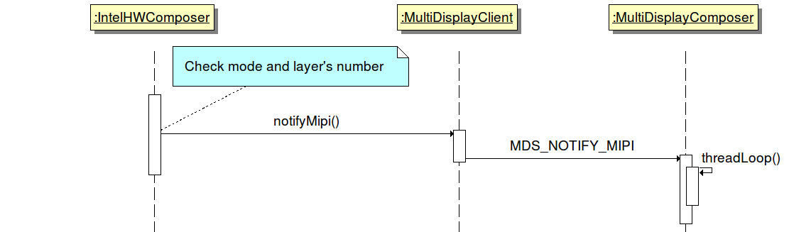
MIPI On/Off Sequence

Slide 14
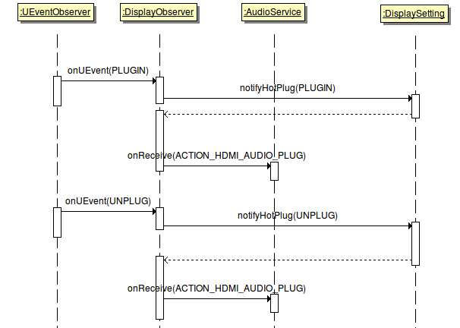
HDMI Hotplug Sequence(Java)

Slide 15
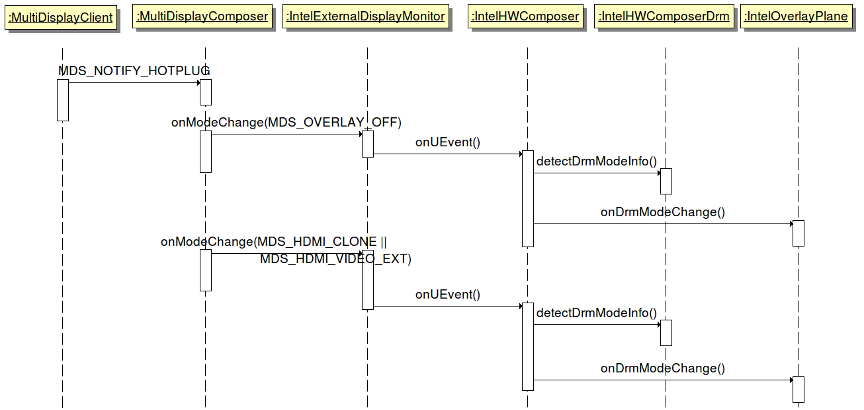
HDMI Hotplug Sequence(C++)

Slide 16
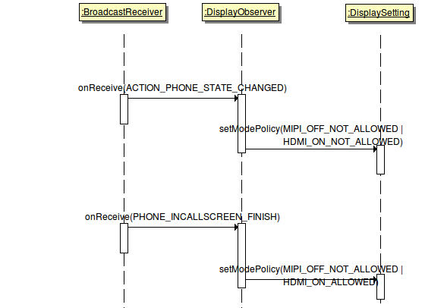
Privacy Protection Sequence(Java)

Slide 17
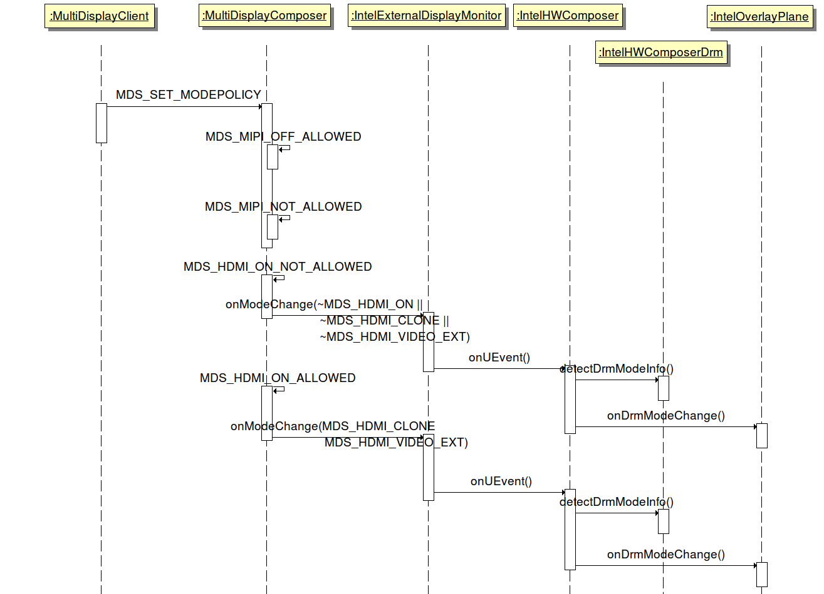
Privacy Protection Sequence(C++)

Slide 18
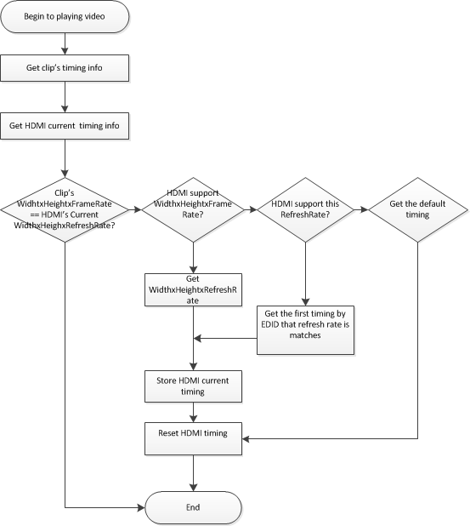
HDMI Timing Dynamic Setting Control Flow

Slide 19
Backup

